Slide 1

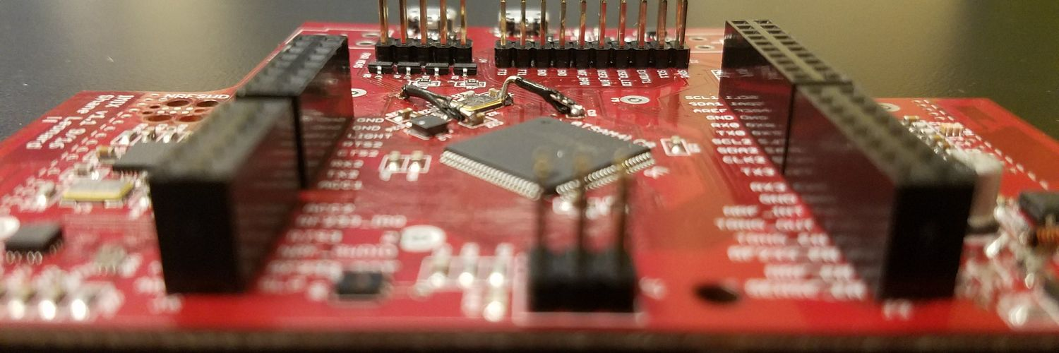
Tock: A Secure Operating System for Microcontrollers
Amit Levy
Octopi Workshop 10/29/18

Slide 2


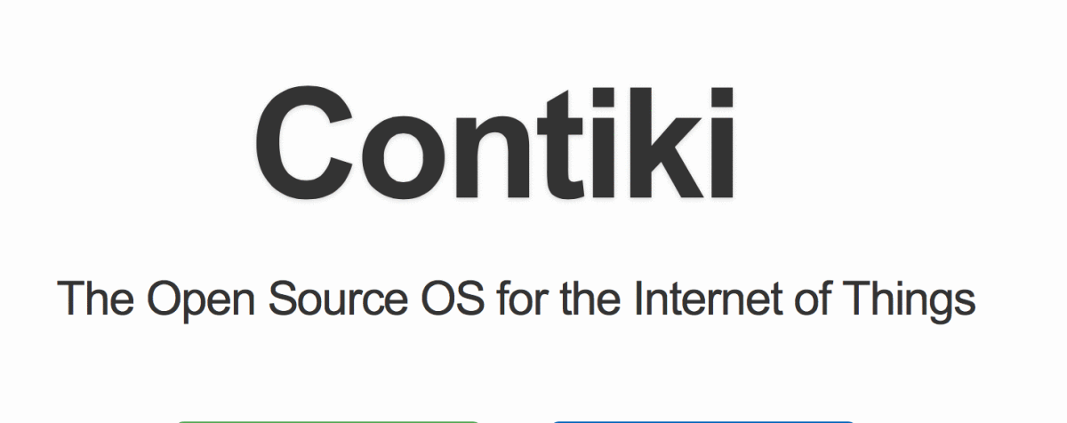
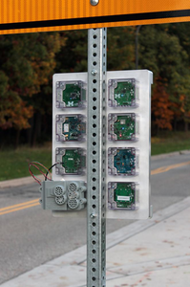
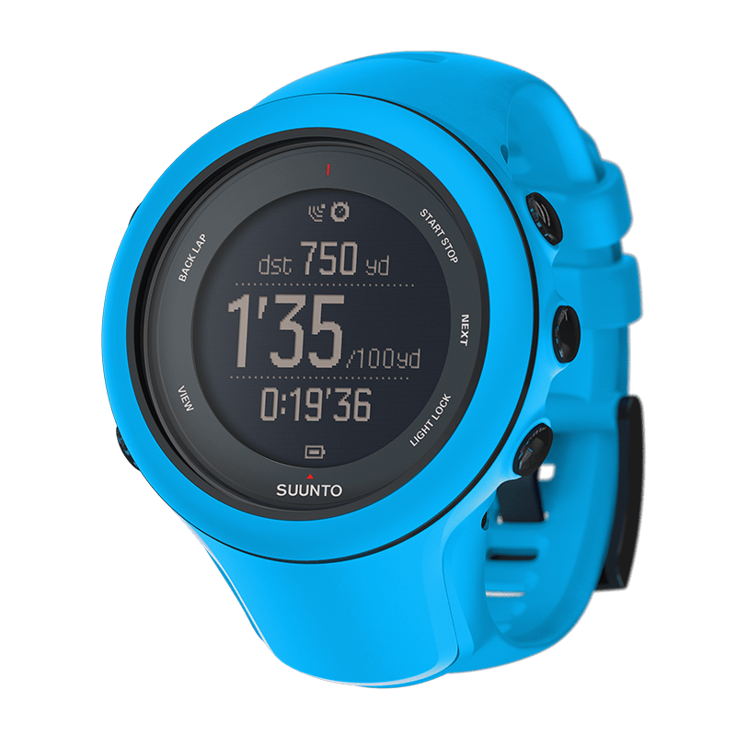

Limitations of Microcontroller Software
Low memory: ~64 kB RAM
No virtual memory
Can’t use Linux!
No isolation
USB authentication keys have multiple functions
Sensor networks run several experiments at once
Fitness watches support different activities
Notes:
Linux + Windows entrenched
Microcontrollers totally different beast
So, mismatch, for example

Slide 3
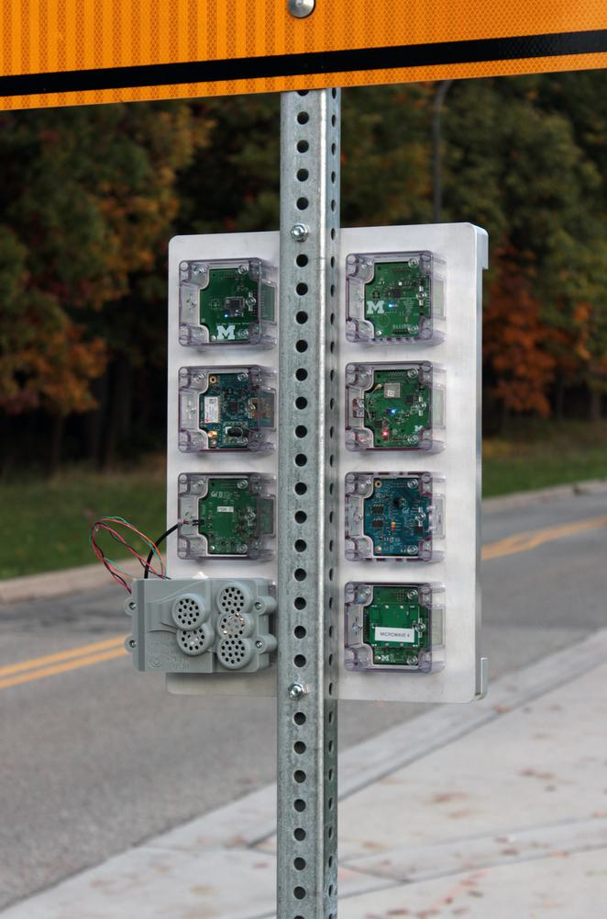
Multi-User Device: Signpost
Modular city-scale sensing
Tracking Ambient conditions
Pedestrian density
Noise monitoring
8 pluggable modules
Microcontroller + Sensors
Several applications per module
Currently deployed @ U.C. Berkeley

Slide 4
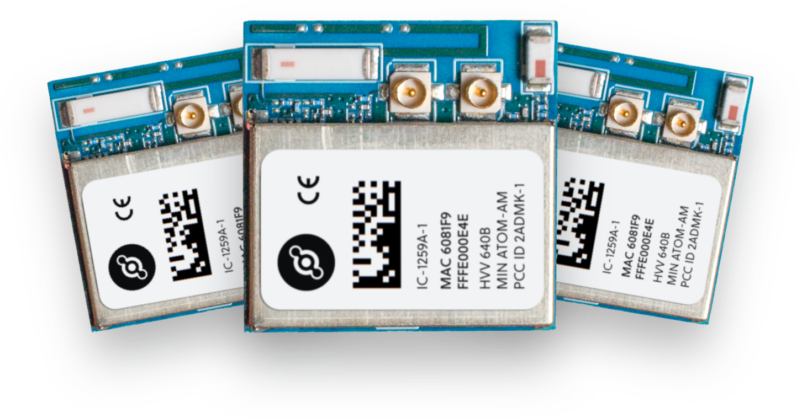
OTA Updates: Helium
End-to-end IoT “solution”
Programmable module
Long-range radio
MCU runs customer services + applications
Abandoned a previous version that used Lua
Next version uses Tock

Slide 5
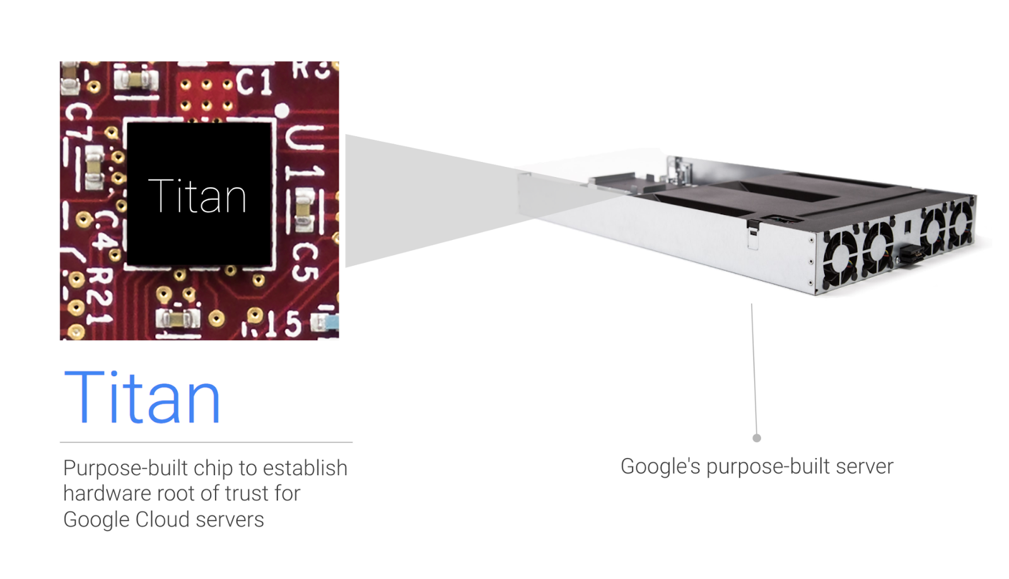
Security Sensitive Device: Google Titan
Google’s Titan chip: security hardened MCU
Server root-of-trust, authentication
Without Tock: a handful of experts audit all code
Open source port of Tock started during internship

Slide 6
Thesis: Embedded Devices are Multiprogrammed
Multiple users running applications concurrently
Applications updated dynamically
Small payloads better
Buggy updates shouldn’t brick devices
Security sensitive devices want least privilege

Slide 7
Tock Embedded OS
Growing open-source community
883 GitHub followers, >100 mailing list subscribers
54 contributors (so far) to main project
~20 contributors to out-of-tree HW ports
>100 developers trained at Tock tutorials
Growing HW support
ARM Cortex-Ms: Atmel SAM4L, Nordic NRF5x, TI CC26xx & TM4C129x, NXP MK66, STM32
RISC-V port at a secret facility outside Boston

Slide 8
Multiprograming a Microcontroller
Memory & Performance Isolation
Power & Clock Control
Peripheral communication busses
Future work

Slide 9
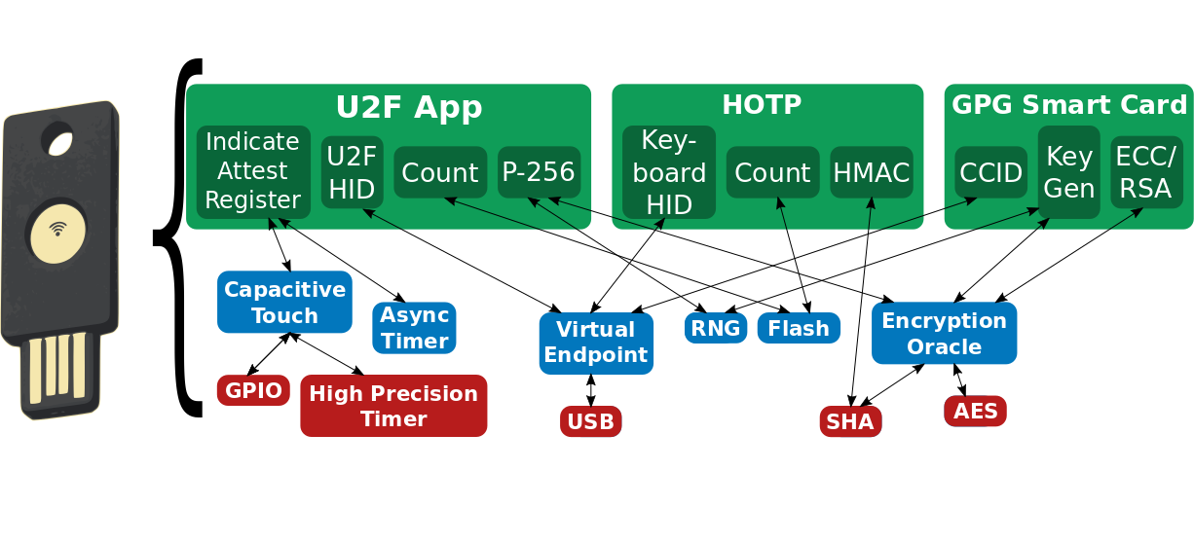
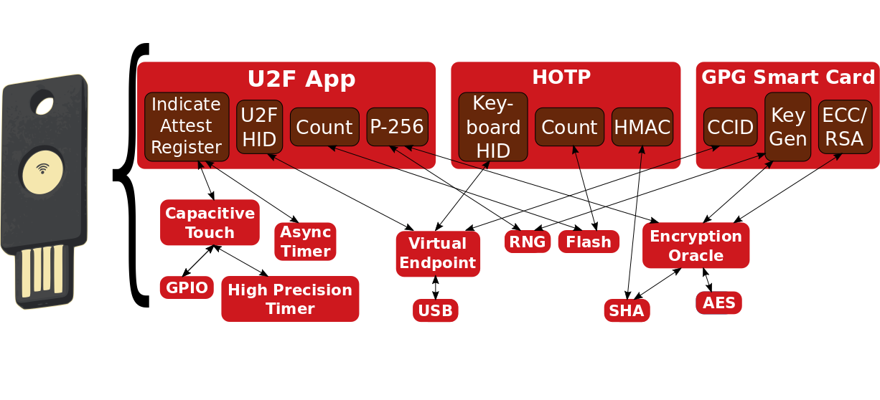
Example: USB Authentication Key
Multiple independent applications
No programmability in favor of security
Result: Handful of programmers control software stack

Slide 10
Platform (~10 developers)
Build the hardware
Responsible for TCB: core kernel, MCU-specific code
Trusted: complete control over firmware & hardware
Goal: possible to correctly extend TCB

Slide 11
OS Services (~1000 developers)
Most OS services come community
Device drivers, networking protocols, timers...
Platform provider can audit but won’t catch all bugs
Goal: protect kernel from safety violations

Slide 12
Applications (~20M developers)
Implement end-user functionality
“Third-party” developers: unknown to platform provider
Potentially malicious
Goal: end-users can install 3rd-party apps

Slide 13
Need New Isolation Techniques
With 64 kB, malloc a serious threat to system stability
No virtual memory
Still need to solve driver isolation
GC’d languages & hardware isolation too resource heavy

Slide 14
New Tools Available
Memory Protection Unit (MPU)
Protection bits for 8 memory regions
Isolate processes for applications
Rust
Non-GC'd type-safe systems language
Prevent safety violations in kernel at very low cost

Slide 15
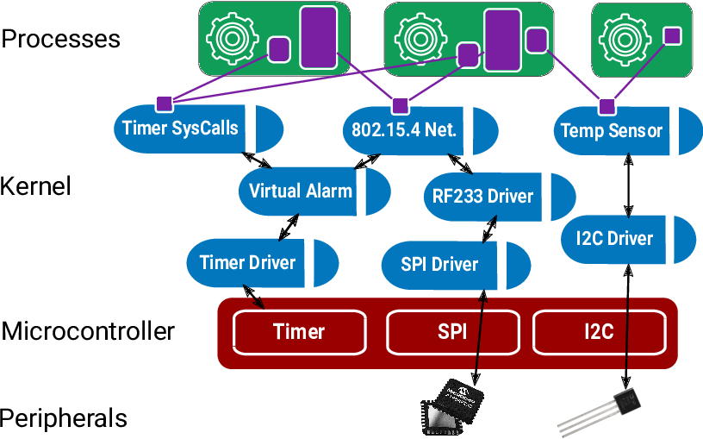
Tock: A Microcontroller OS
Processes: Use the Memory Protection Unit
Capsules: Type-safe Rust API for safe driver development
Grants: Bind dynamic kernel resources to process lifetime

Slide 16


Tock’s Isolation Mechanisms
Processes
Standalone executable in any language
Isolation enforced at runtime
Higher overhead
Applications
Totally untrusted
Capsules
Rust code linked into kernel
Isolation enforced at compile-time
Lower overhead
Used for device drivers, protocols, timers...
Trusted for liveness, not safety

Slide 17
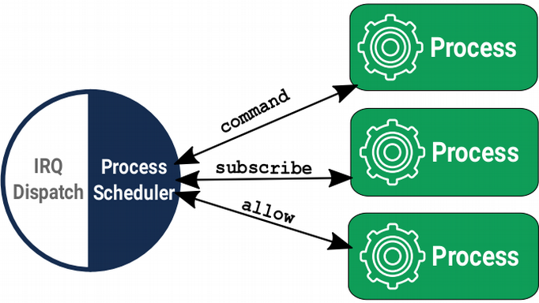
Processes
Hardware-isolated concurrent programs in any language
MPU to protect memory regions without virtualization
Independent stack, heap, static variables
Run dynamically, compiled with position independent code
Scheduled preemptively
System calls & IPC for communication
Notes:
* Similar to processes in other systems
* Each process has dedicated block of memory for…
* Enforced with the hardware
* scheduled preemptively
* Unlike capsules, Instead of methods & references…
* Nice property
* Compared to capsules...

Slide 18
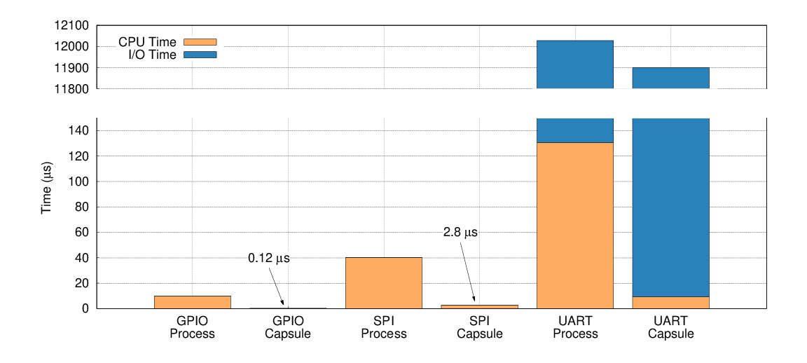
Process Overhead
Dedicated memory region (at least a stack)
Context switch for communication (340 cycles)
Notes:
For operations, like quickly toggling a I/O pin, non-starter
For others, like sending a large string over serial, no biggie
11ms vs. 100us

Slide 19
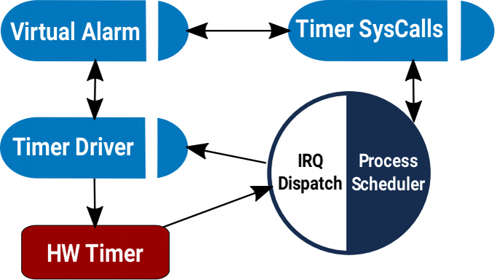
Capsules
A Rust module and structs
Single-threaded event-loop with asynchronous I/O
Single stack
No heap
Communicate via references & method calls, often inlined

Slide 20
Capsule Resource Overhead
Example 1: “blink”
 | ROM size (B) | RAM size (B)
Tock | 3208 | 916
TinyOS | 5296 | 72
Example 2: Networked sensor
 | ROM size (B) | RAM size (B)
Tock | 41744 | 9704
TinyOS | 39604 | 10460

Slide 21
Capsule Isolation
struct DMAChannel {
length: u32,
base_ptr: *const u8,
}
impl DMAChannel {
fn send_buffer(&self, buf: &'static [u8]) {
self.length = buf.len();
self.base_ptr = buf.as_ref();
}
}
Exposes the DMA base pointer and length as a Rust slice
Type-system guarantees user has access to memory
Won’t be deallocated before DMA completes
Notes:
* Example of pretty rich isolation semantics
* From DMA capsule for one of the MCUs
* DMAChannel capsule sets length and base pointer in MMIO registers.
* Don’t want to expose this to clients
* Instead, fields are private, and clients sets buffer through a method that takes a Rust slice.
* Getting the developer to express what they want through types

Slide 22
Working Example: Software Timer
Software Timer
Kernel
HW Alarm

Slide 23
Statically allocate timer state?
FAIL
Software Timer Driver
No memory available to handle this request.
Static allocation must trade off memory efficiency and maximum concurrency

Slide 24
What About Dynamic Allocation?
FAIL
AES Driver
Software Timer Driver
Bluetooth Driver
Can lead to unpredictable shortages.
One process’s demands impacts capabilities of others.
Notes:
Lead to unpredictable shortages. Worse, the fault could happen anywhere, including…
Haven’t gotten the right information from developer
Who should be charged for allocation?
When is it safe to free?

Slide 25
Grants: Per-Process Kernel Heaps
Allocations for one process do not affect others
System proceeds if one grant section is exhausted
All process resources freed on process termination
Grant section
RAM
Heap
Process
Accessible
Memory
Data
Stack
Flash
Code
Notes:
Grants solve this problem by…
Kernel heap, called grant section, allocated in process memory, but can’t access

Slide 26
Grants: Per-Process Kernel Heaps
Software Timer Driver
Grants balance safety and reliability of static allocation with flexibility of dynamic allocation
Notes:
* Process requests for timer => new grant allocated
* More than one request? more grants are allocated.
* Memory exhausted? kill the process, no affect on the rest of the system.
* And can restart process immediately
Recall, grant sections live in… but contain kernel data, so… need to make sure...

Slide 27
Grants use the type-system to ensure references only accessible when process is live
// Can’t operate on timer data here
timer_grant.enter(process_id, |timer| {
// Can operate on timer data here
if timer.expiration > cur_time {
timer.fired = true;
}
});
// timer data can’t escape here
fn enter<'a, F>(&'a self, pid: ProcId, f: F) →
where F: for<'b> FnOnce(&'b mut T)
Notes:
Capsules can’t store direct references to granted memory
Instead, the enter the grant section by passing in the id of the process.
Enter checks process is still alive, and executes a closure provided by capsule, passing in a reference to the actual data.
It’s important that this reference not escape, so use a feature of Rust, lifetimes, to enforce this property.

Slide 28
Grants: No Cross-Process Structures
Shared Heap
Process 1
Process 2
Software Timer Driver

Slide 29
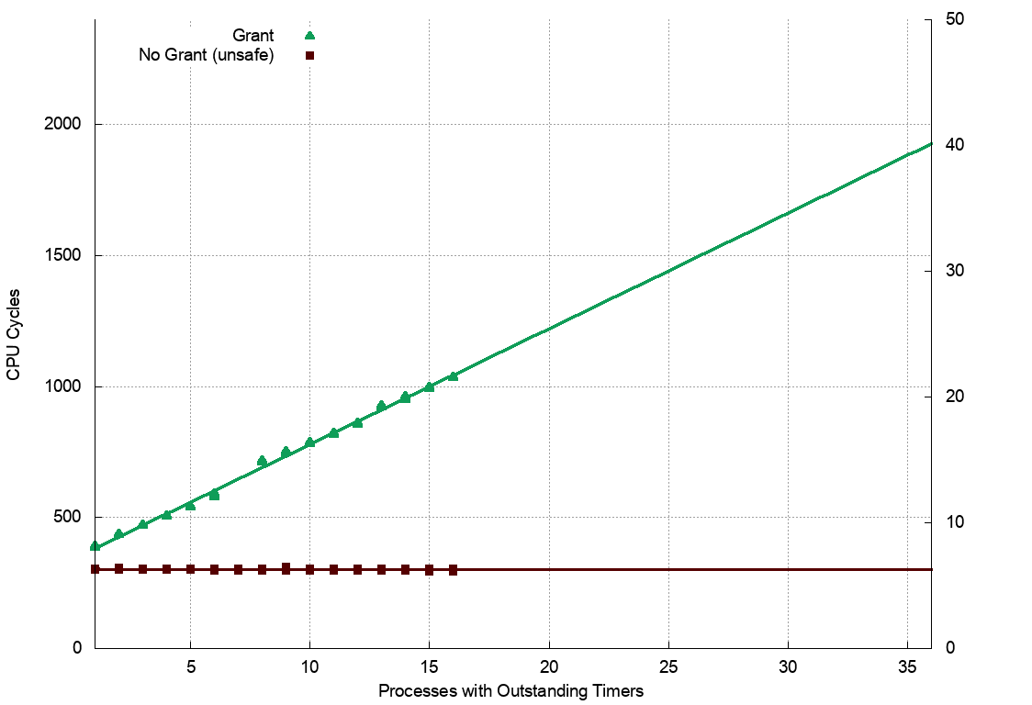
Grants: No Cross-Process Structures
μS

Slide 30
Multiprograming a Microcontroller
Memory & Performance Isolation
Power & Clock Control
Peripheral communication busses
Future work

Slide 31
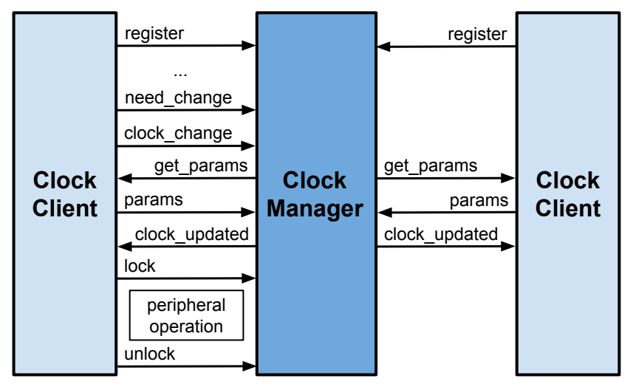
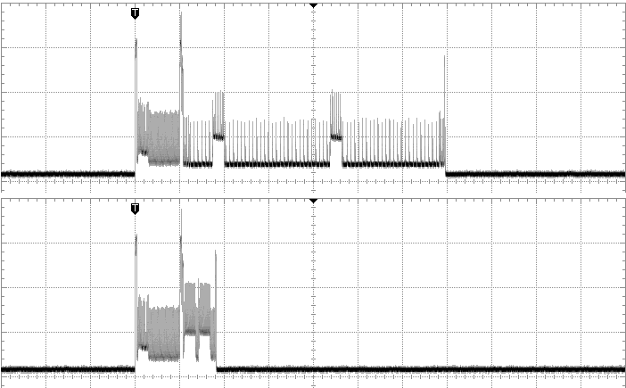
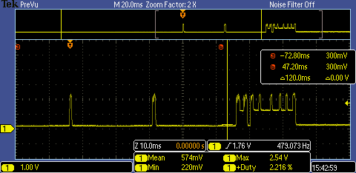
Power State & Clock Control
Power draw combo of duty cycle and active draw
What’s the deepest sleep state we can drop to?
Which clock should drive active peripherals?
Multiprogramming makes both harder!
RCSYS
RCFAST
Impact of Active Clock Selection
Duty Cycle a Function of Workload

Slide 32
Multiprograming a Microcontroller
Memory & Performance Isolation
Power & Clock Control
Peripheral communication busses
Future work

Slide 33
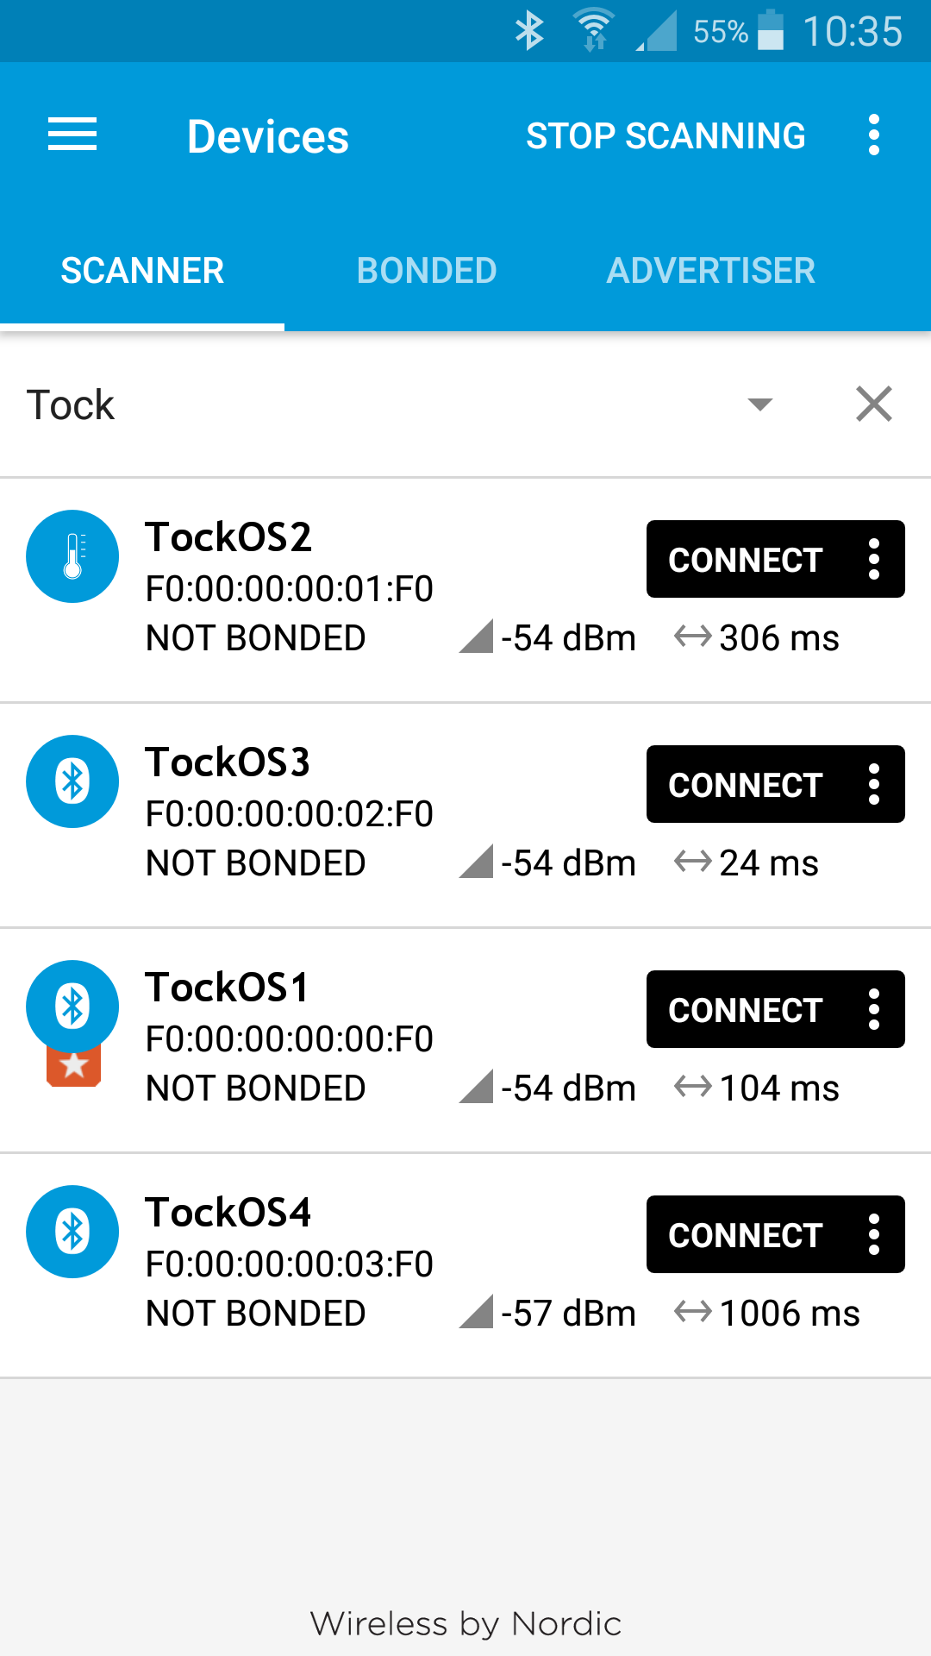
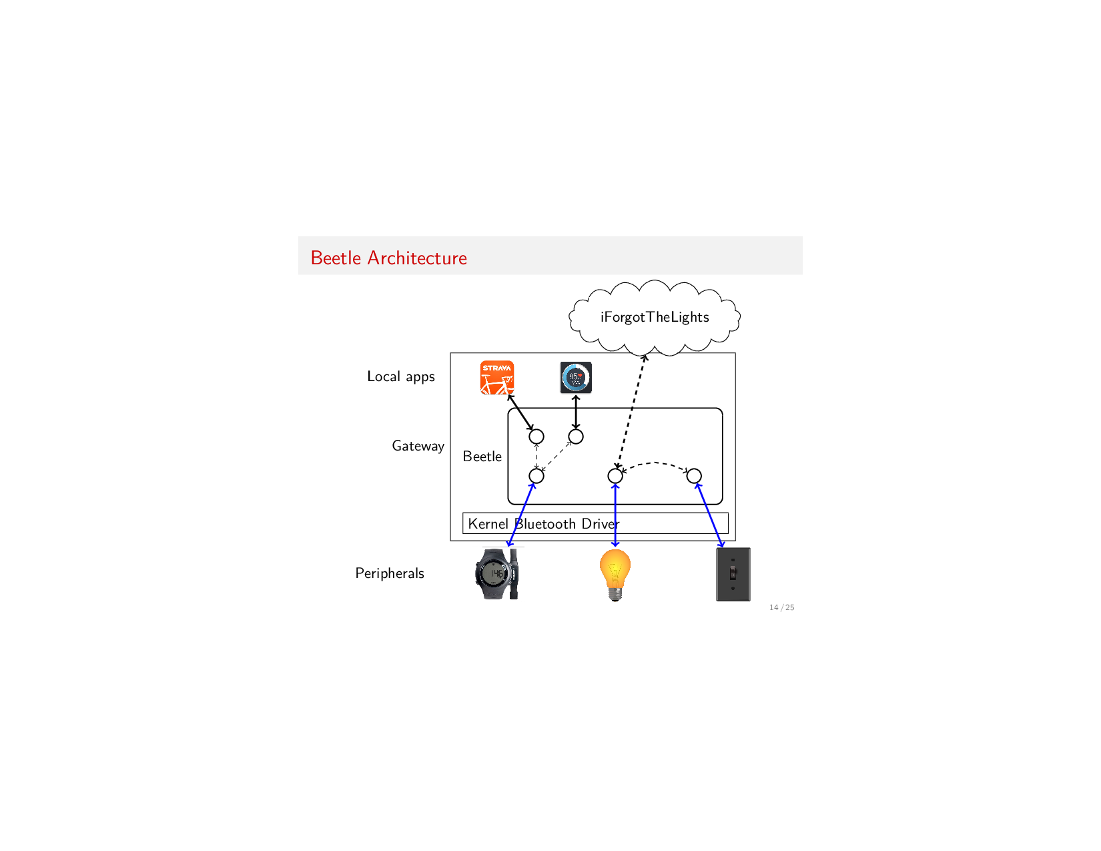
Multiprogramming a Peripheral
A platform must support all possible applications
Efficient protocols may not be so efficient anymore
Peripheral communication not designed for multiprogramming
How to restart individual components?
How to isolate services?
Virtualizing vs. Multiplexing

Slide 34
Multiprograming a Microcontroller
Memory & Performance Isolation
Power & Clock Control
Peripheral communication busses
Future work

Slide 35
Future Work
Writing & Enforcing security policies
For the kernel: language-based capability system?
For processes: permissions without a file system?
For networked applications: cryptographic tokens?
Debugging embedded applications
Security implications
Logging
More applications, more hardware
RISC-V, x86
Wearables, sensor networks, security devices

Slide 36
Tock: A Secure Operating System for Microcontrollers
Embedded devices are multiprogrammable
Security, Software Updates, Multi-tenancy
Tension between isolation and resources
Traditional approaches insufficient for low memory
New programming languages & hardware features help
Must also rethink: power management, networking, security policies...

Slide 37
Evaluating with Practitioners
Researchers working with Tock
Half-day tutorials (~100 people)
Open source community (45+ contributors)
Embedded Systems class at Stanford

Slide 38
Security is an End-to-End Property
Is threat model realistic?
Can system builders extend TCB safely?
Can developers build applications?

Slide 39
Realistic Threat Model?
 | Signpost | Helium | Titan
Applications | Researchers | Customers | App Developers
Capsules | Module builders | Community, Helium Inc. | Product developers
Platform | Signpost authors | Helium Inc. | Titan team

Slide 40
Security is an End-to-End Property
✓
Is threat model realistic?
Can system builders extend TCB safely?
Can developers build applications?

Slide 41
Safely Extend the TCB?
Rule out common errors by design:
Synchronization with interrupt handlers
Untrusted user pointers
Use-after-free

Slide 42
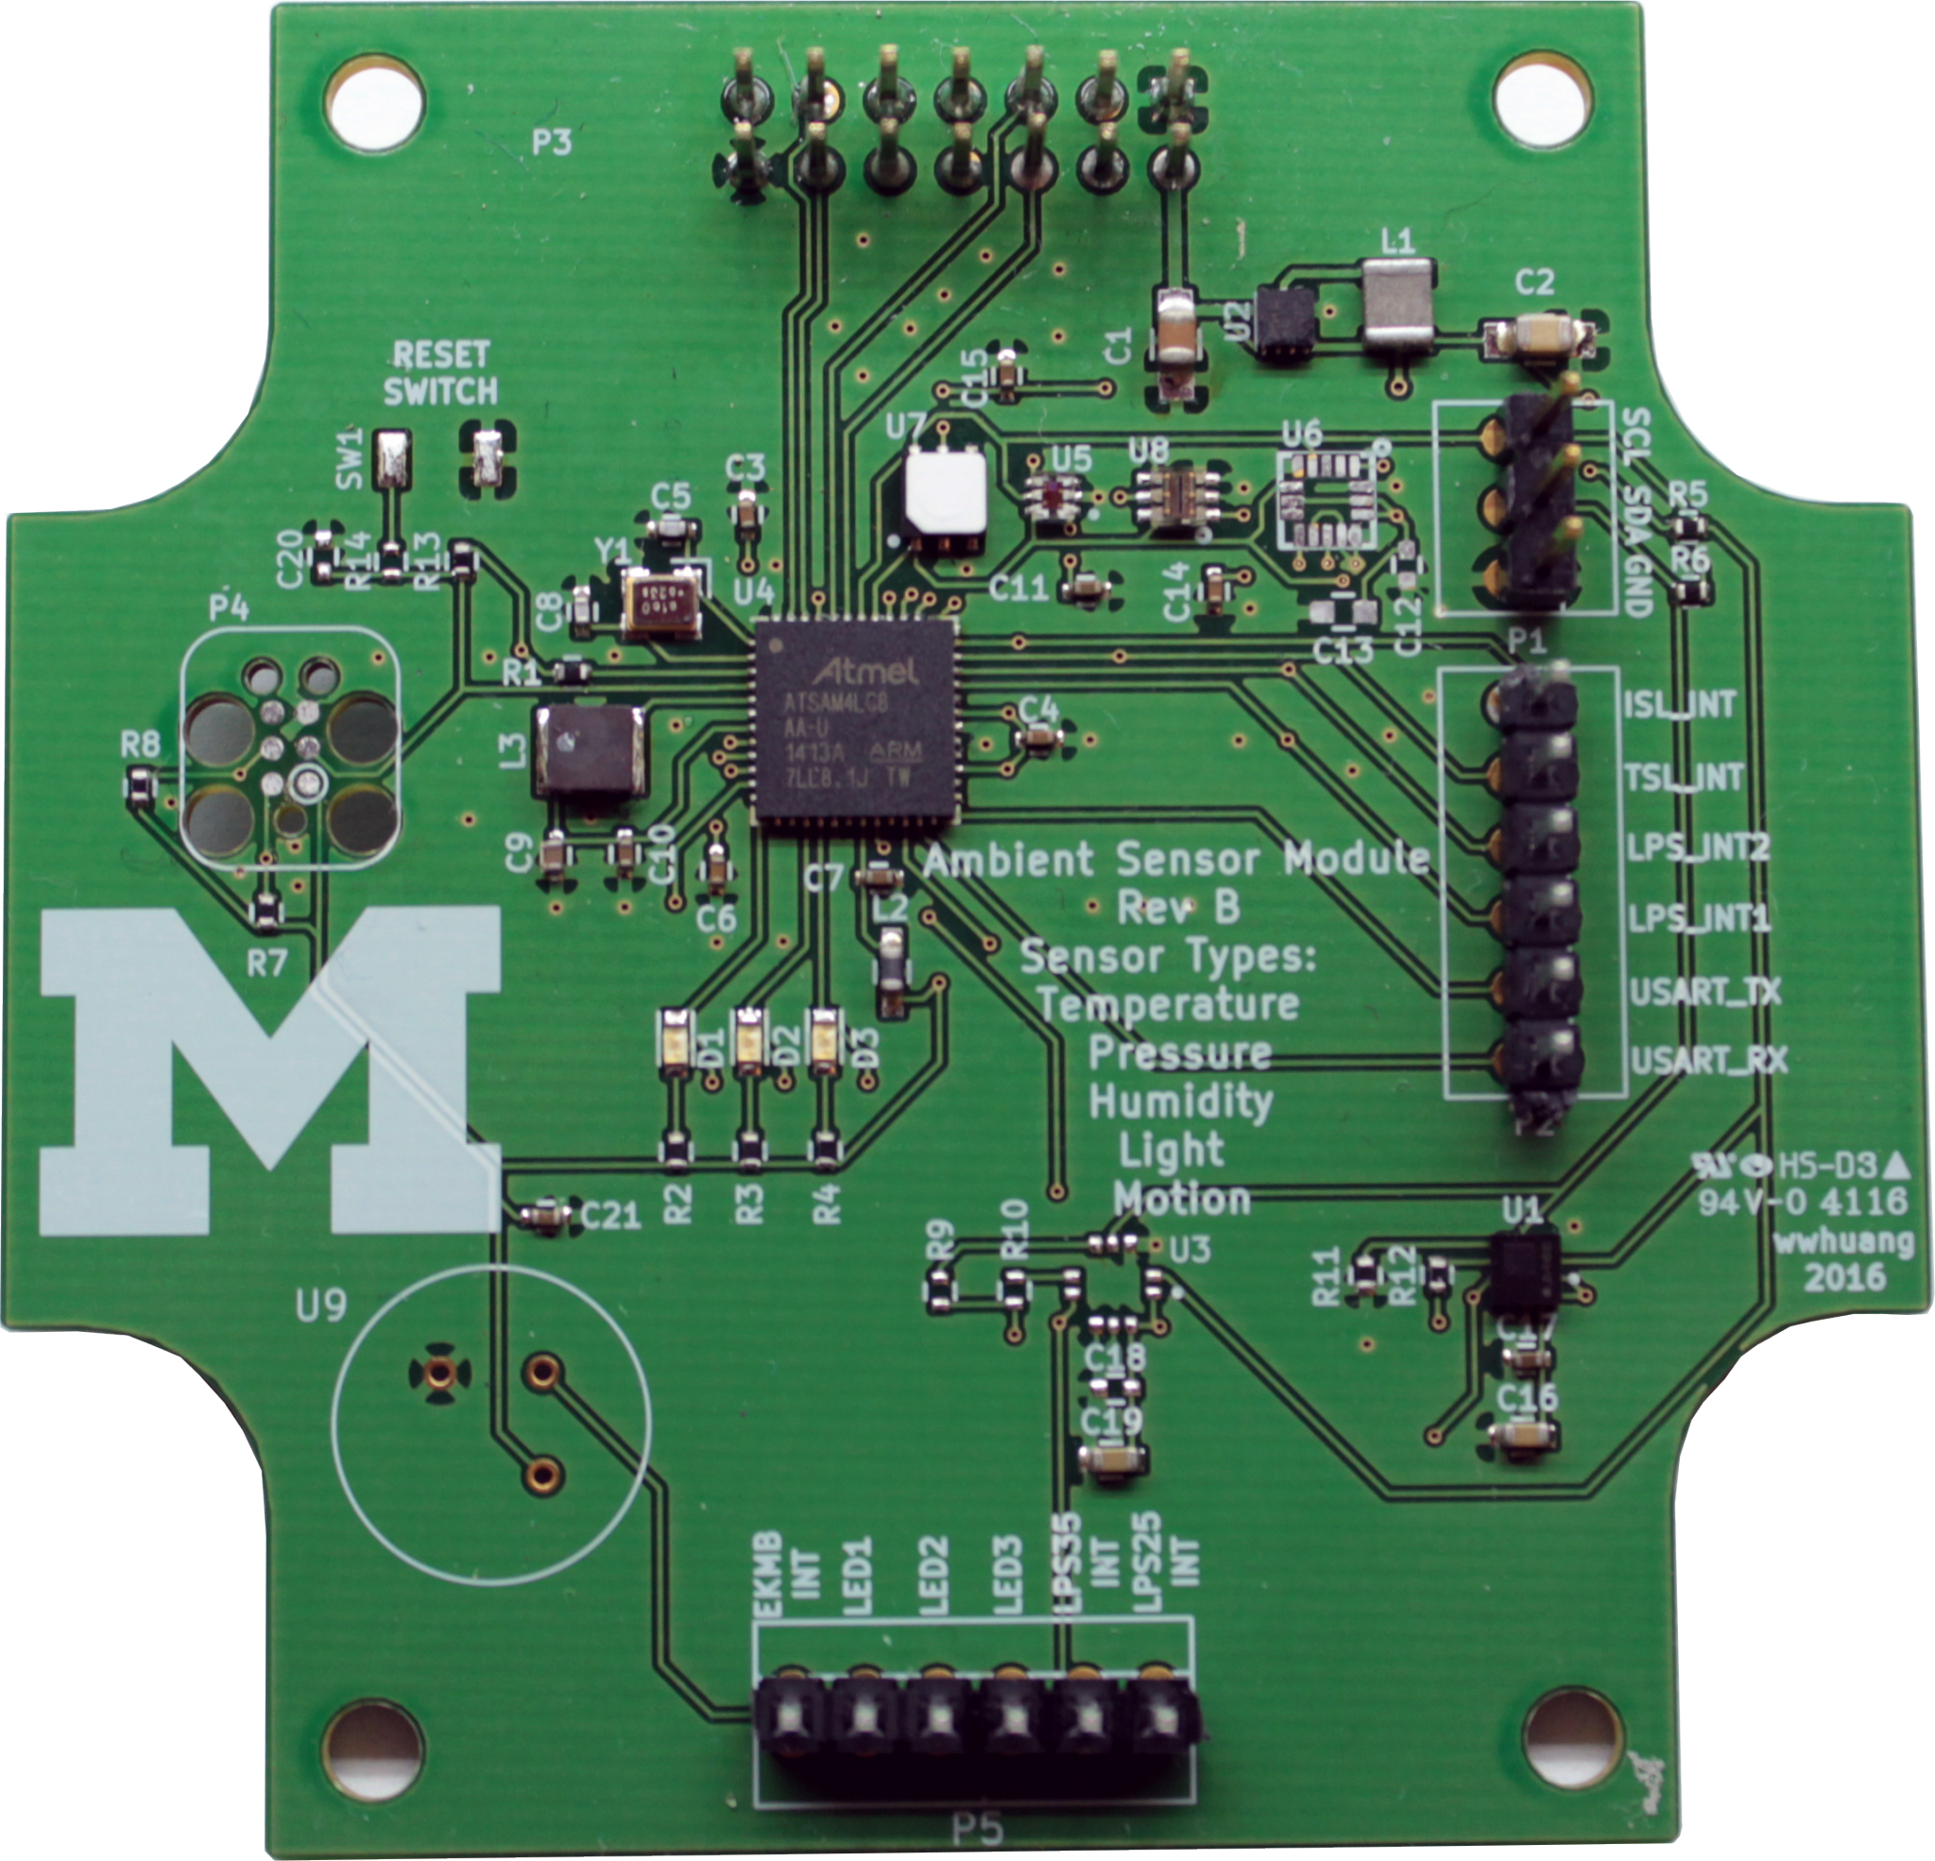
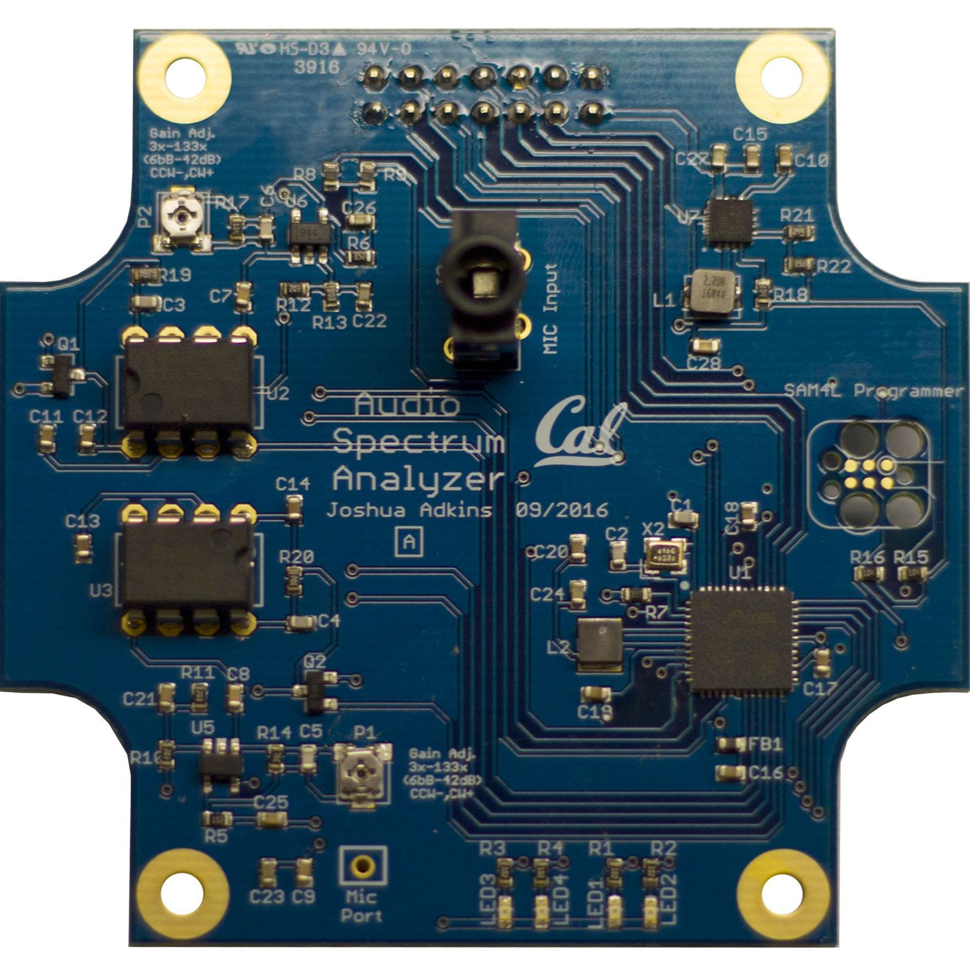
Tock on Signpost
Each Signpost module runs a Tock kernel
 | Ambient Module | Audio Module
Process LoC | 6990 | 6688
Capsules LoC | 4479 | 3985
Platform LoC | 3252 | 3244
 | 405 “unsafe” | 381 “unsafe”

Slide 43
Security is an End-to-End Property
✓
✓
Is threat model realistic?
Can system builders extend TCB safely?
Can developers build applications?

Slide 44
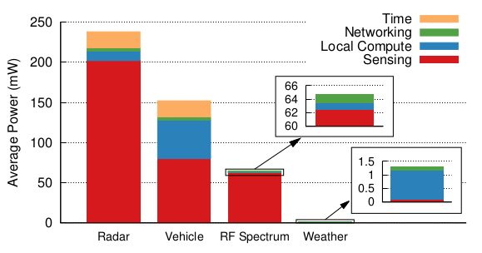
Writing Applications?
Energy consumption on Signpost applications*
*Adkins et al., IPSN’18

Slide 45
Future Work with Tock
Efficient Clock Management
Can’t statically choose clock domains
Idea: Hide clock choices from app
Low-power wireless networking
6lowpan implementation overheads
Multi-application Bluetooth Low-Energy peripherals
Security Policies
Specify access rights for processes/apps
Enforce high-level policies on capsules
Tagline: An “App Store” for embedded systems

Slide 46


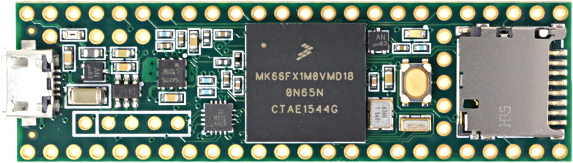
Teensy (Embedded Systems Class)
Platform LoC | 4055
Unsafe LoC | 170

Slide 47
Rust Features
Type and memory safe
No buffer overflows, dangling pointers, type confusion, use-after-free…
Compile-time enforced type system
No type artifacts at run time
No garbage collection
Control over memory layout and execution
Runtime behavior similar to C

Slide 48
Rust’s Ownership
Key Property: Deallocate memory as soon as owner out of scope
{
let x = Resource::new();
}
When the scope exits, x is no longer valid and the memory is “freed”
{
let x = Resource::new();
let y = x;
println!(“{}”, y); // OK: value moved
println!(“{}”, x); // compilation error!
}

Slide 49
Borrowing
fn transform(x: &mut Resource) {
// the borrow is implicitly released.
}
let mut my_resource = Resource::new();
transform(&mut my_resource);
// my_resource still valid here
Just a pointer at runtime
Mutable references (&mut) must be unique
Shared references (&) cannot mutate the value
Notes:
Rust uses this property to get things like thread-safety
But more fundamental requirement

Slide 50
What About Circular Data-Structures?
SoftwareTimer
VirtualAlarm
Alarm
HWAlarm

Slide 51
Sum Types vs. Shared Mutability
enum NumOrPointer {
Num(u32),
Pointer(&mut u32)
}
$ rustc test.rs
error[E0506]: cannot assign to ‘external‘
because it is borrowed
// n.b. will not compile
let external : &mut NumOrPointer;
if let Pointer(internal) = external {
*external = Num(0xdeadbeef);
*internal = 12345;
// Kaboom: we’ve just written ‘12345‘
// to the address ‘0xdeadbeef‘
}
Existential types for imperative languages, Dan Grossman, ESOP’02

Slide 52
Interior Mutability
Safe if we avoid mutability + aliasing concurrently
Examples from Rust core library:
Cell: Copy-in/out or replace, no direct references
Mutex: mutual-exclusion on internal reference
Can write our own with different semantics:
TakeCell: non-blocking mutual-exclusion
Used in Tock for storing large buffers
Developer expresses: Which part of data is mutable?

Slide 53
pub struct SoftwareTimer {
alarm: &VirtualAlarm,
...
}
pub struct VirtualAlarm {
next_alarm: Cell<u32>,
alarm: &HWAlarm,
client: &SoftwareTimer,
...
}
pub struct HWAlarm {
regs: [VolatileCell<u32>; 16],
client: &VirtualAlarm,
...
}
SoftwareTimer
VirtualAlarm
Alarm
HWAlarm

